Slide 1
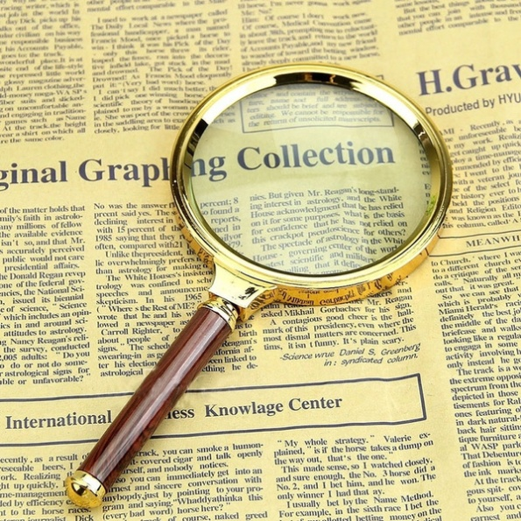
What’s coming up?
Future events

Slide 2
To find out more click on the list!
Philatelic Congress of Great Britain
Midpex
The Royal Philatelic Society London
Autumn Stampex
London 2022

Slide 3
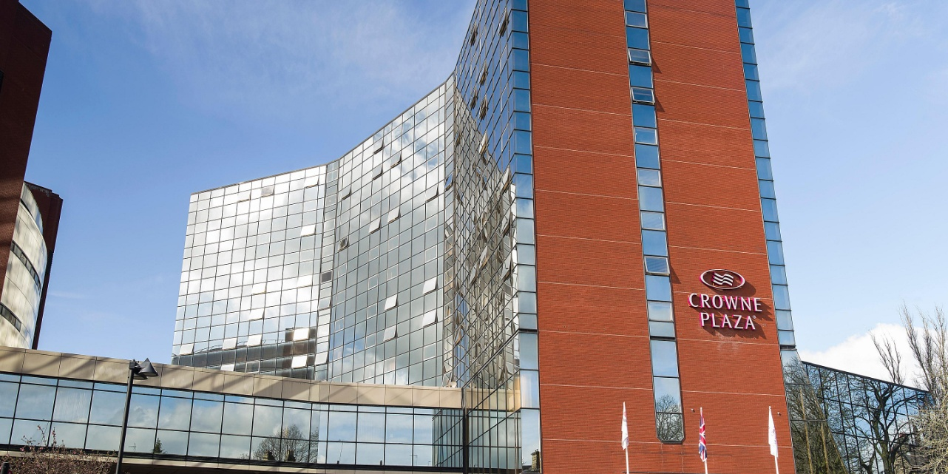
The 103rd Philatelic Congress of Great Britain this year is being held in Harrogate at the Crowne Plaza hotel, 23 - 26 September 2021
The event will also host the signing of the Roll of Distinguished Philatelists – the RDP. This marks 100 years since the roll was first signed at the 8th Congress in May 1921 – in Harrogate
For more information or to book your place at the event contact Steven Harrison, ABPS Vice Chairman, at:
vicechair@abps.org.uk or call 0121 313 0671
Philatelic Congress of
Great Britain

Slide 4
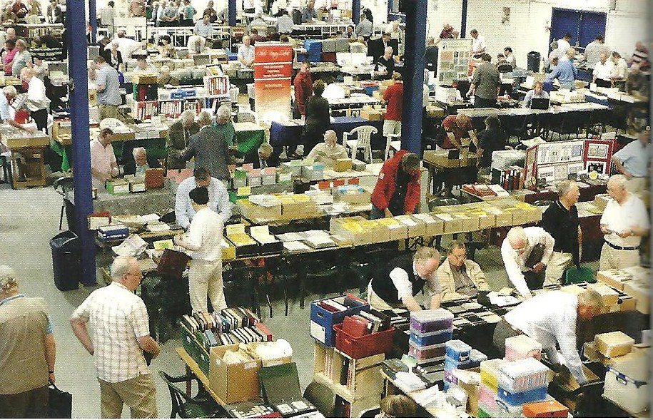
Midpex
Saturday 3rd July 2021
Warwickshire Event Centre
Opening Hours 10.00am - 4.00pm
Biennial exhibition first held in 1995 and attended by stamp collectors
from across the UK.
This event brings together Specialist Societies with local, national and international dealers covering all aspects of Philately.
Get in touch
+44 (0) 1926 613887
info@warwickshireeventcentre.co.uk

Slide 5
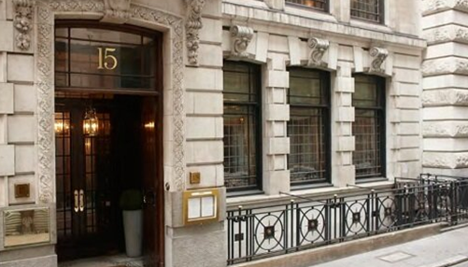
The Royal Philatelic Society London hopes to re-start meetings at its premises in Abchurch Lane on 24 June 2021 with a display from the West Midlands Region.
For more information contact
the society on:
Tel: +44 (0) 20 7486 1044
Fax: +44 (0) 20 7486 0803
E-mail secretary@rpsl.org.uk

Slide 6
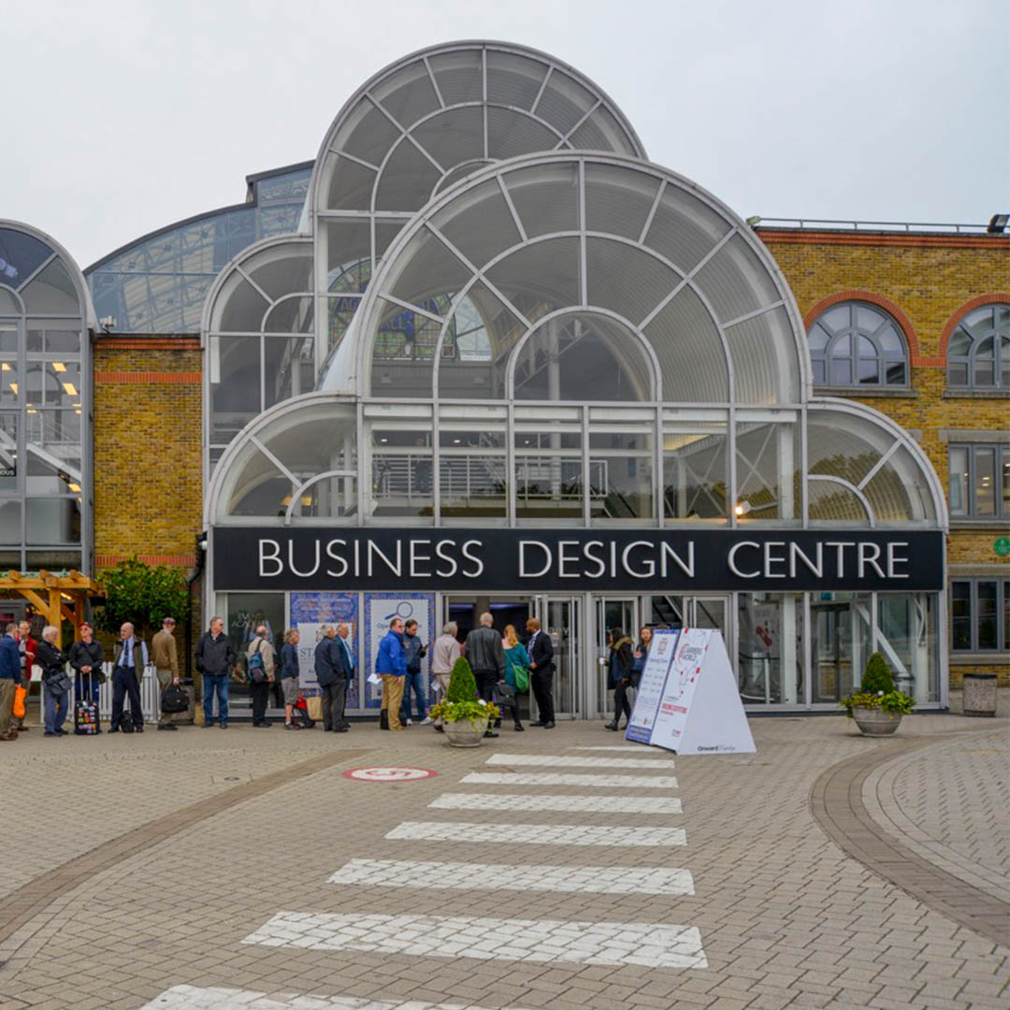
Autumn Stampex
29 September – 2 October 2021
Stampex International - The British National Stamp Exhibition - is the largest bi-annual philatelic event in Europe.
Business Design Centre
52 Upper St, The Angel, London, N1 0QH

Slide 7
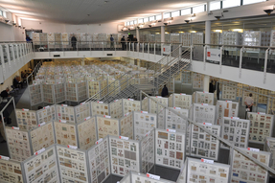
London 2022 International Stamp Exhibition
19 February 2022 - 26 February 2022
A FIP Accredited Exhibition with all exhibiting classes, including Traditional, Postal History, Thematic, Open, Maximaphily and Literature.
Expect over 125 stand-holders comprising dealers, auctioneers, philatelic publishers and postal administrations, including Royal Mail.
Venue
Business Design Centre
52 Upper St, The Angel, London, N1 0QH

