Slide 1

Presentation
A little care goes a long, long way
The Sun Hotel, Hitchin,
25-26 November 2016
Association of British Philatelic Societies

Slide 2
Cheap and Expensive Points
£££££ Expensive
Rarity 20
Importance 10
£££ Condition 10
££ Treatment 20 (10 + 10)
Research 15
Knowledge 20
Presentation 5
£ Cheap

Slide 3
Cheap and Expensive Points
£££££ Expensive
Rarity 20
Importance 10
£££ Condition 10
££ Treatment 20 (Selection)
Research 15
Knowledge 20
Presentation 5
£ Cheap

Slide 4
Why is exhibiting different?
Half of the points are for the material you are showing ….
But half of the points are for philatelic expertise and skill in creating an exhibit
What you are showing
50%
How you are showing it
50%

Slide 5
What do the GREVs say?
What are the GREVs?
General regulations of the FIP for the evaluation of competitive exhibits at FIP exhibitions
What is FIP?
Fédération Internationale de Philatélie

Slide 6
An evaluation of the
overall
aesthetic appearance of the exhibit

Slide 7
Presentation
Writing up should be clear, concise and relevant
The method of presentation should show the material to the best effect
The whole exhibit should show balance: in time, in material, and in appearance

Slide 8
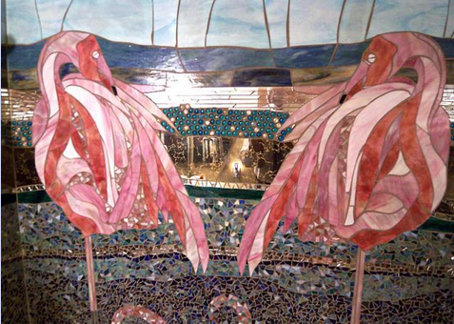


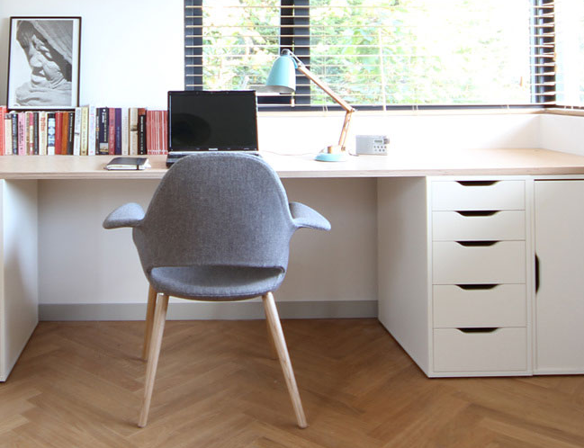
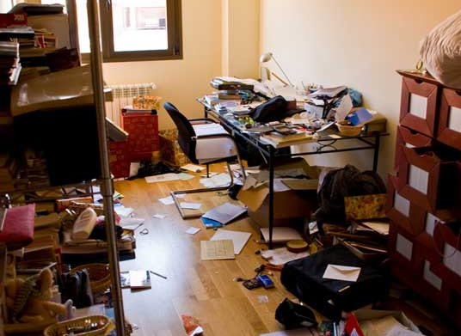

Make sure that it says
what you want it to say …
At an exhibition, the exhibitor is not at the exhibition to speak for their exhibit.
So the way an exhibit looks and is constructed is very important.
It has to speak for itself.

Slide 9
Why begin with presentation?
Because if an exhibit is not
attractive, organised, coherent,
balanced and complete ...
... any judge will probably start with the idea that the exhibit is not likely to be very good.
This is an exaggeration, but it is fatal to ignore.

Slide 10
Presentation
A Fundamental Principle
of Exhibit Construction.
If there is no coherent and structured
approach to Presentation and Layout ....
.... then Treatment
won’t be coherent and structured,
and it will be hard for the jury to understand.

Slide 11
Presentation isn’t just about layout ….

Slide 12
Choice of Material
Aesthetically pleasing
Good condition
Interesting to look at
Interesting contents
Helps show knowledge
Demonstrates rarity
Relevant to the exhibit
Is not duplicated
Good research material
Takes the story forward
Is varied in usage and destination
Choice of Material
Aesthetically pleasing
Good condition
Interesting to look at
Interesting contents
Helps show knowledge
Demonstrates rarity
Relevant to the exhibit
Is not duplicated
Good research material
Takes the story forward
Is varied in usage and destination

Slide 13
Thinking about Presentation
Balance
Balance of each page. Ensure the page does not look too quirky
Balance of each frame. Double sheets and key items in appropriate positions
Balance of material in the exhibit
No large chronological gaps

Slide 14
Thinking about Presentation
Cohesion
Page frames, running headers and flags or Coats of Arms etc.
Mounts and shapes
Fonts and use of bold, or italic lettering
Pages and protectors
Use of colours
Illustrations and maps

Slide 15
Thinking about Presentation
Cohesion
Amount of write up
Page visual effect
Exhibition frame visual effect
Location of key items in the frame
Story chapters beginning and ending location
White spaces
Drawing attention to key items

Slide 16
Paper and Print
Why is this important?
It demonstrates knowledge of conservation.
It shows concern for, and pride in the material.
It shows respect for the audience.

Slide 17
Paper and Print
Paper
1. Size: A4 or A3
A3 gives more flexibility, particular for large items and ephemera – acid free: this means alkaline buffered paper, free of lignin and ground wood
2. Colour: White, off white, cream – NO dark colours
3. Weight: The best your printer can take
4. Protectors
Good quality, chemically inert polyester, e.g. Melinex®, Mylar™ without surface coatings or plasticisers.

Slide 18
Paper and Print
Layout
Frames around your items – colour and thickness – experiment - or
Card of contrasting colour for matting (backing) – not useful in Open Philately: Frames around pages can lead to problems.
Typeface must be clear and easy to read
Do not mix too many different typefaces
It is better to use the same typeface
Vary the point size for headings, sub-headings, text, explanation
Use bold or italics for variations
Print Colour: Black, or a very dark colour
For example brown on cream paper in Traditional Classes

Slide 19
Paper and Print
Headers and Footers
Header on the introductory page with exhibit title to the left
Header on following pages with sub-heading to the left and sub-titles to the right and/or an illustrative symbol
Footer with exhibit title and page number at the bottom right
Point Size:
Headers – large and/or capital letters
Footers – small and lighter colour, for example a grey tone

Slide 20
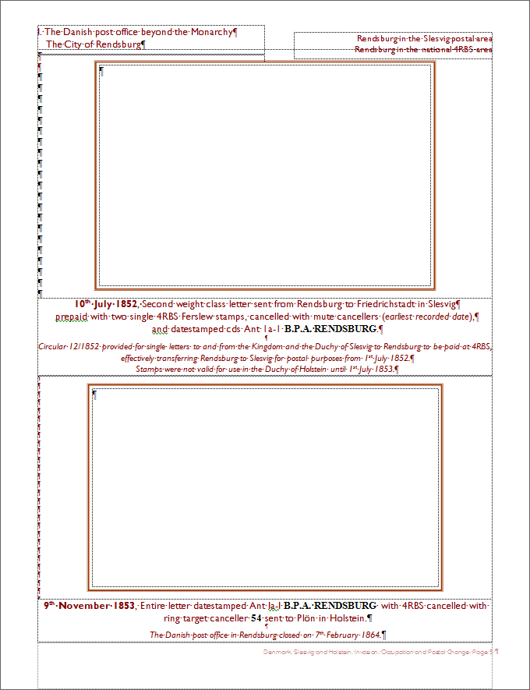
This is a word document
Clarendon pages
288mm x 218mm
Margins
Top 2cm
Left 1.5 cm
Right 1.5cm
Bottom 1.5cm
Fonts
Gill Sans 12 point
Times New Roman
Arial
Bible Script
Fraktur
Footer
Denmark, Slesvig and Holstein, Invasion,
Occupation and Postal Change: Page 5

Slide 21
Top Left Text Box
No line
Left to margin
1cm below the top of the page
Is always the Chapter Heading
Never begin a chapter in the
middle of a row

Slide 22
Top Right Text Box
No line
Right to margin
1.3 cm below the top of the page
Describes, in one line, the
item(s) on the page
And tells if they are
especially important

Slide 23
Bottom Text Box
No line
Width is margin to margin
Bottom to Margin

Slide 24
Top Bounding Box
No line
Height and Width is 0.5cm wider than the Item being shown
Centred 2.5cm below Page

Slide 25
Centre Text Box
No line
Width is margin to margin
i.e. 288mm – 30mm = 258mm

Slide 26
Next Bounding Box
No line
Height and Width is 0.5cm wider than the Item being shown

Slide 27
All four boxes are justified
vertically
1
2
3
4

Slide 28
And centred horizontally

Slide 29
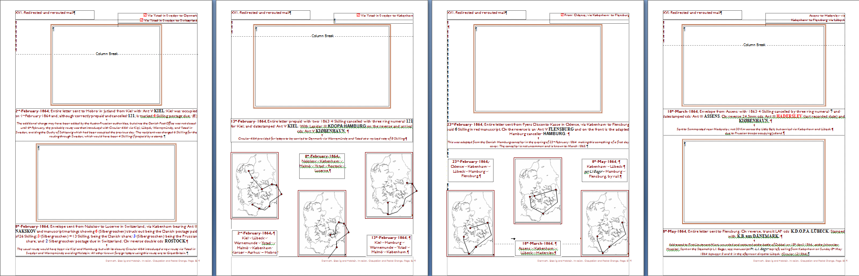
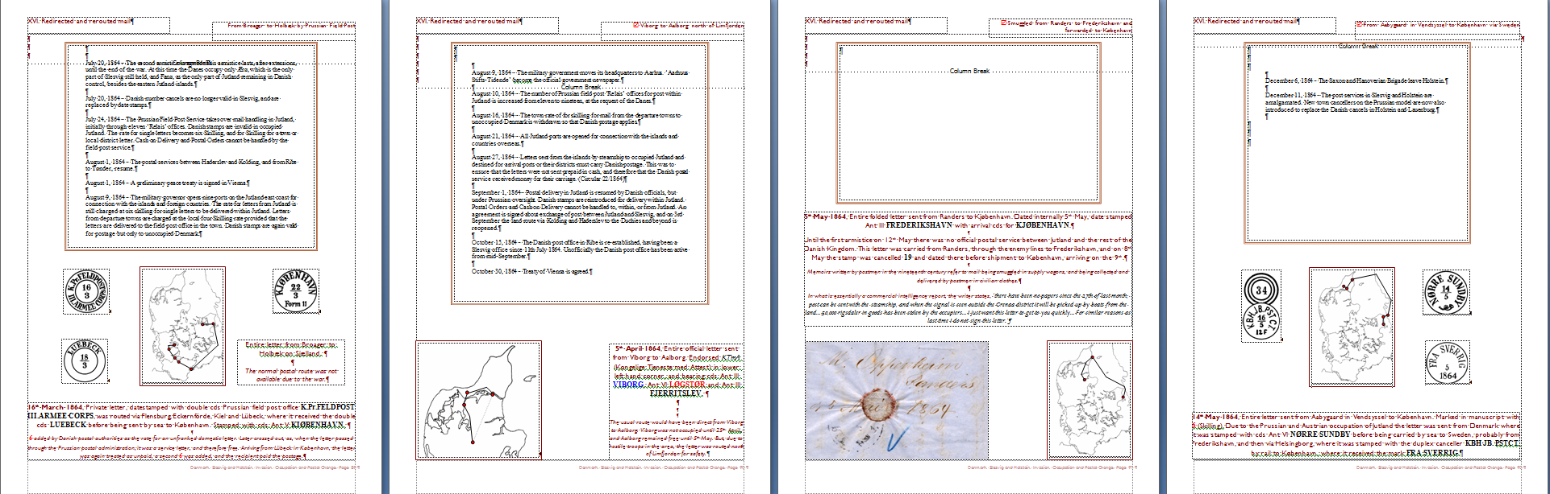
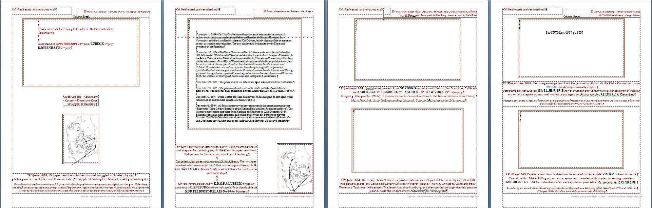
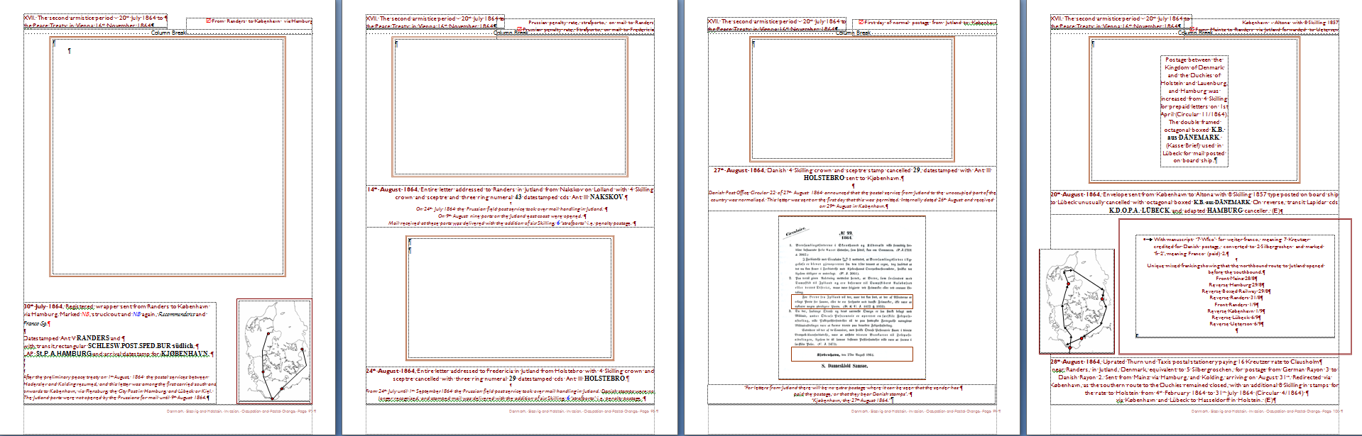

Slide 31


The Chapter
Headings tell
The story
You can include
sub-headings
if they help to
carry the story
forward
They lead the
Judge through
Your exhibit.
They exemplify
Your treatment

Slide 32
The
Information
Boxes are the
detail of the
story
They are short
one-liners to
Show the judge
the material
They can
demonstrate
Importance
☑
Or draw
attention to
Variety

Slide 33
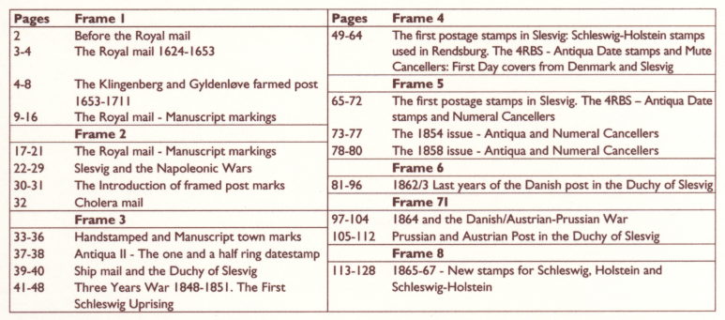
Exhibit Structure
A plan of an eight frame exhibit

Slide 34
Exhibit Structure
A plan of an eight frame exhibit

Slide 35


The heading in the plan
is the same as the heading
on the page

Slide 36
The heading in the plan
is the same as the heading
on the page
The colour of the text is the same as the colour of the cancel

Slide 37
The heading in the plan
is the same as the heading
on the page
The colour of the text is the same as the colour of the cancel
The typeface in the text is the same as the typeface in the date stamp

Slide 38
The heading in the plan
is the same as the heading
on the page
The colour of the text is the same as the colour of the cancel
The typeface in the text is the same as the typeface in the date stamp
The date is in bold, the date structure is always the same
dd mm yyyy

Slide 39
The heading in the plan
is the same as the heading
on the page
The colour of the text is the same as the colour of the cancel
The typeface in the text is the same as the typeface in the date stamp
The date is in bold, the date structure is always the same
dd mm yyyy
This is an important piece

Slide 40
The heading in the plan
is the same as the heading
on the page
The colour of the text is the same as the colour of the cancel
The typeface in the text is the same as the typeface in the date stamp
The date is in bold, the date structure is always the same
dd mm yyyy
This is an important piece
Manuscript in the text means manuscript on the item

Slide 41
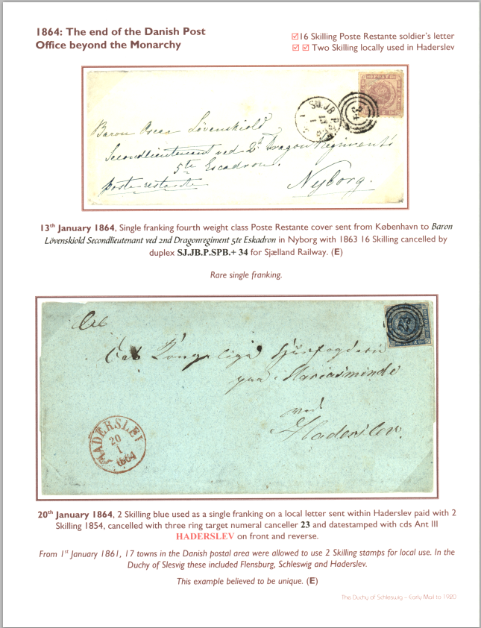
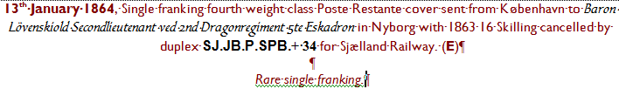
A page from another exhibit
The same conventions
are used throughout
Why?
Clear, simple, visible
statements of rarity
Because when you have taught
the judge what the conventions
are, you don’t have to do it again,
and again, and again
The judges might view
your exhibit 15 minutes in the
frames, although they will have
used the Introductory Page for
Advance preparation

Slide 42
ABPS Exhibitions and International Committee
c/o The Philatelic Fund
Suite 145E, Business Design Centre
52 Upper Street
London N1 0QH
© ABPS 2016

